Slide 1
WHAT FMS am I? To play this game with your educators you will need to go to the slideshow tab and click from beginning. Use the speech bubbles as your clues to the question what FMS am I? You may like to use a timer for each question, try 20 seconds for a challenge! On each slide – 1 click will remove the square over the photos and a second click reveals the answer. Feel free to work in teams and tally your correct answers.

Slide 2
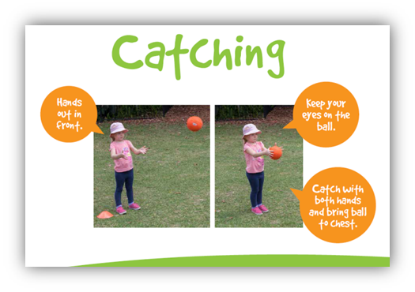
QUIZ Time!
What FMS am I?

Slide 3
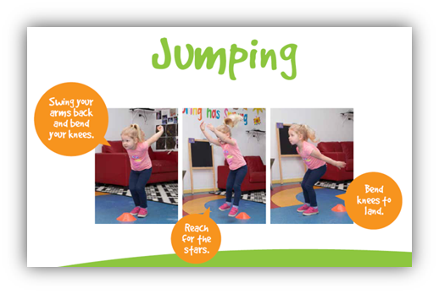
Question 1
Notes:
1

Slide 4
Question 2
Notes:
2

Slide 5
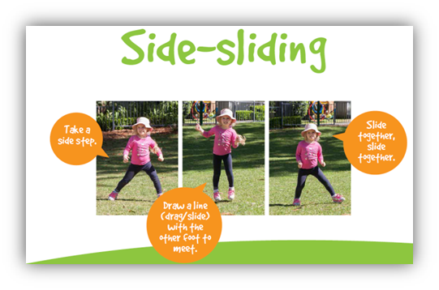
Question 3
Notes:
3

Slide 6
Question 4
Notes:
4

Slide 7
Question 5
Notes:
5

Slide 8
Question 6
Notes:
6

Slide 9
Question 7
Notes:
7

Slide 10
Question 8
Notes:
8

Slide 11
Question 9
Notes:
9

Slide 12
Question 10
Notes:
10

Slide 13
Question 11
Notes:
11

Slide 14
Question 12
Notes:
12

Slide 15
Question 13
Notes:
13

